Slide 1
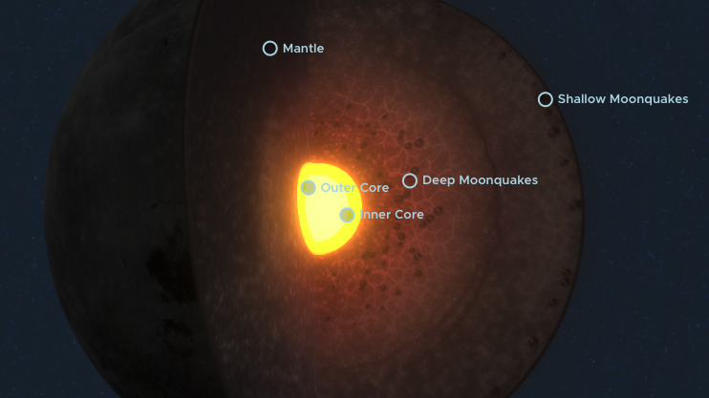
GEOL593: Seismology and Earth Structure, Spring 2023
Lecture 11: Planetary Seismology 2: Seismology on the Moon
4/04/23

Slide 2
Class schedule
 | Dates | Topic | Lab assignment
Week 1: | Jan 17, Jan 19 | Course overview | Lab 1: Python crash course
Week 2: | Jan 24, Jan 26 | Seismic signal processing | Lab 2: Introduction to Obspy
Week 3: | Jan 31, Feb 2 | Moment Tensors/ Inverse methods | Lab 3: Moment tensor inversion
Week 4: | Feb 7, Feb 9 | 🤮 No class, Ross ill | Seismic wave propagation 1
Week 5: | Feb 14, Feb 16 | Lab 4: Reference Earth models: The “1D” Earth | Seismic wave propagation 2
Week 6: | Feb 21, Feb 23 | Lab 5: Surface wave dispersion | Surface waves and normal modes
Week 7: | Feb 28, Mar 2 | Lab 6: Normal modes | Imaging Earth Structure 1: Seismic tomography
Week 8: | Mar 7, Mar 9 | Lab 7: Seismic Tomography | Imaging Earth Structure 2: Seismic discontinuities / Research paper discussion
Week 9: |  | Spring break
Week 10: | Mar 21, Mar 23 | Lab 8. Receiver Functions | Anisotropy and anelasticity
Week 11: | Mar 28, Mar 30 | Planetary seismology 1 | Lab 9: InSight- Seismology on Mars
Week 12: | Apr 4, Apr 6 | Planetary seismology 2
Week 13: | Apr 11, Apr 13 | Machine learning in seismology 1 | Lab 10: Earthquake detection
Week 14: | Apr 18, Apr 20 | Machine learning in seismology 2
Week 15: | Apr 25, Apr 27 | Frontiers of seismology: What’s next?
Week 16: | May 2, May 4 | Research paper presentations

Slide 3
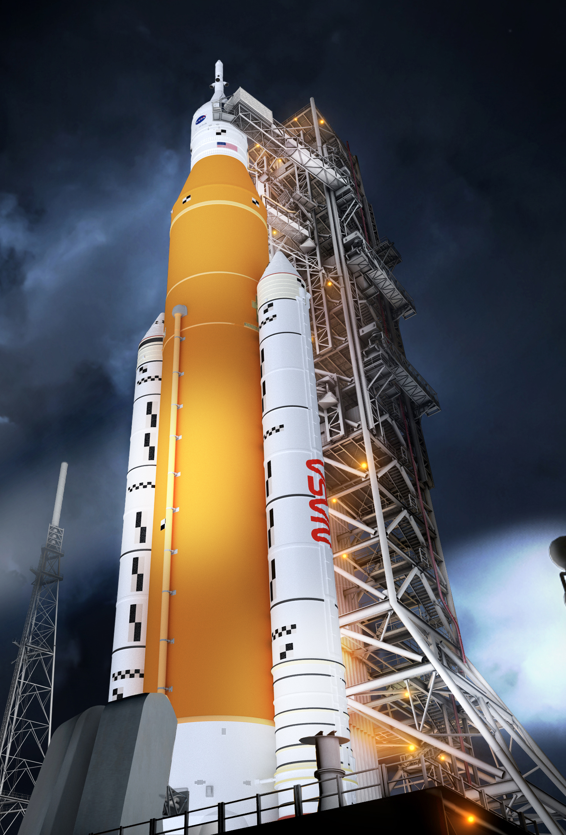


Slide 4
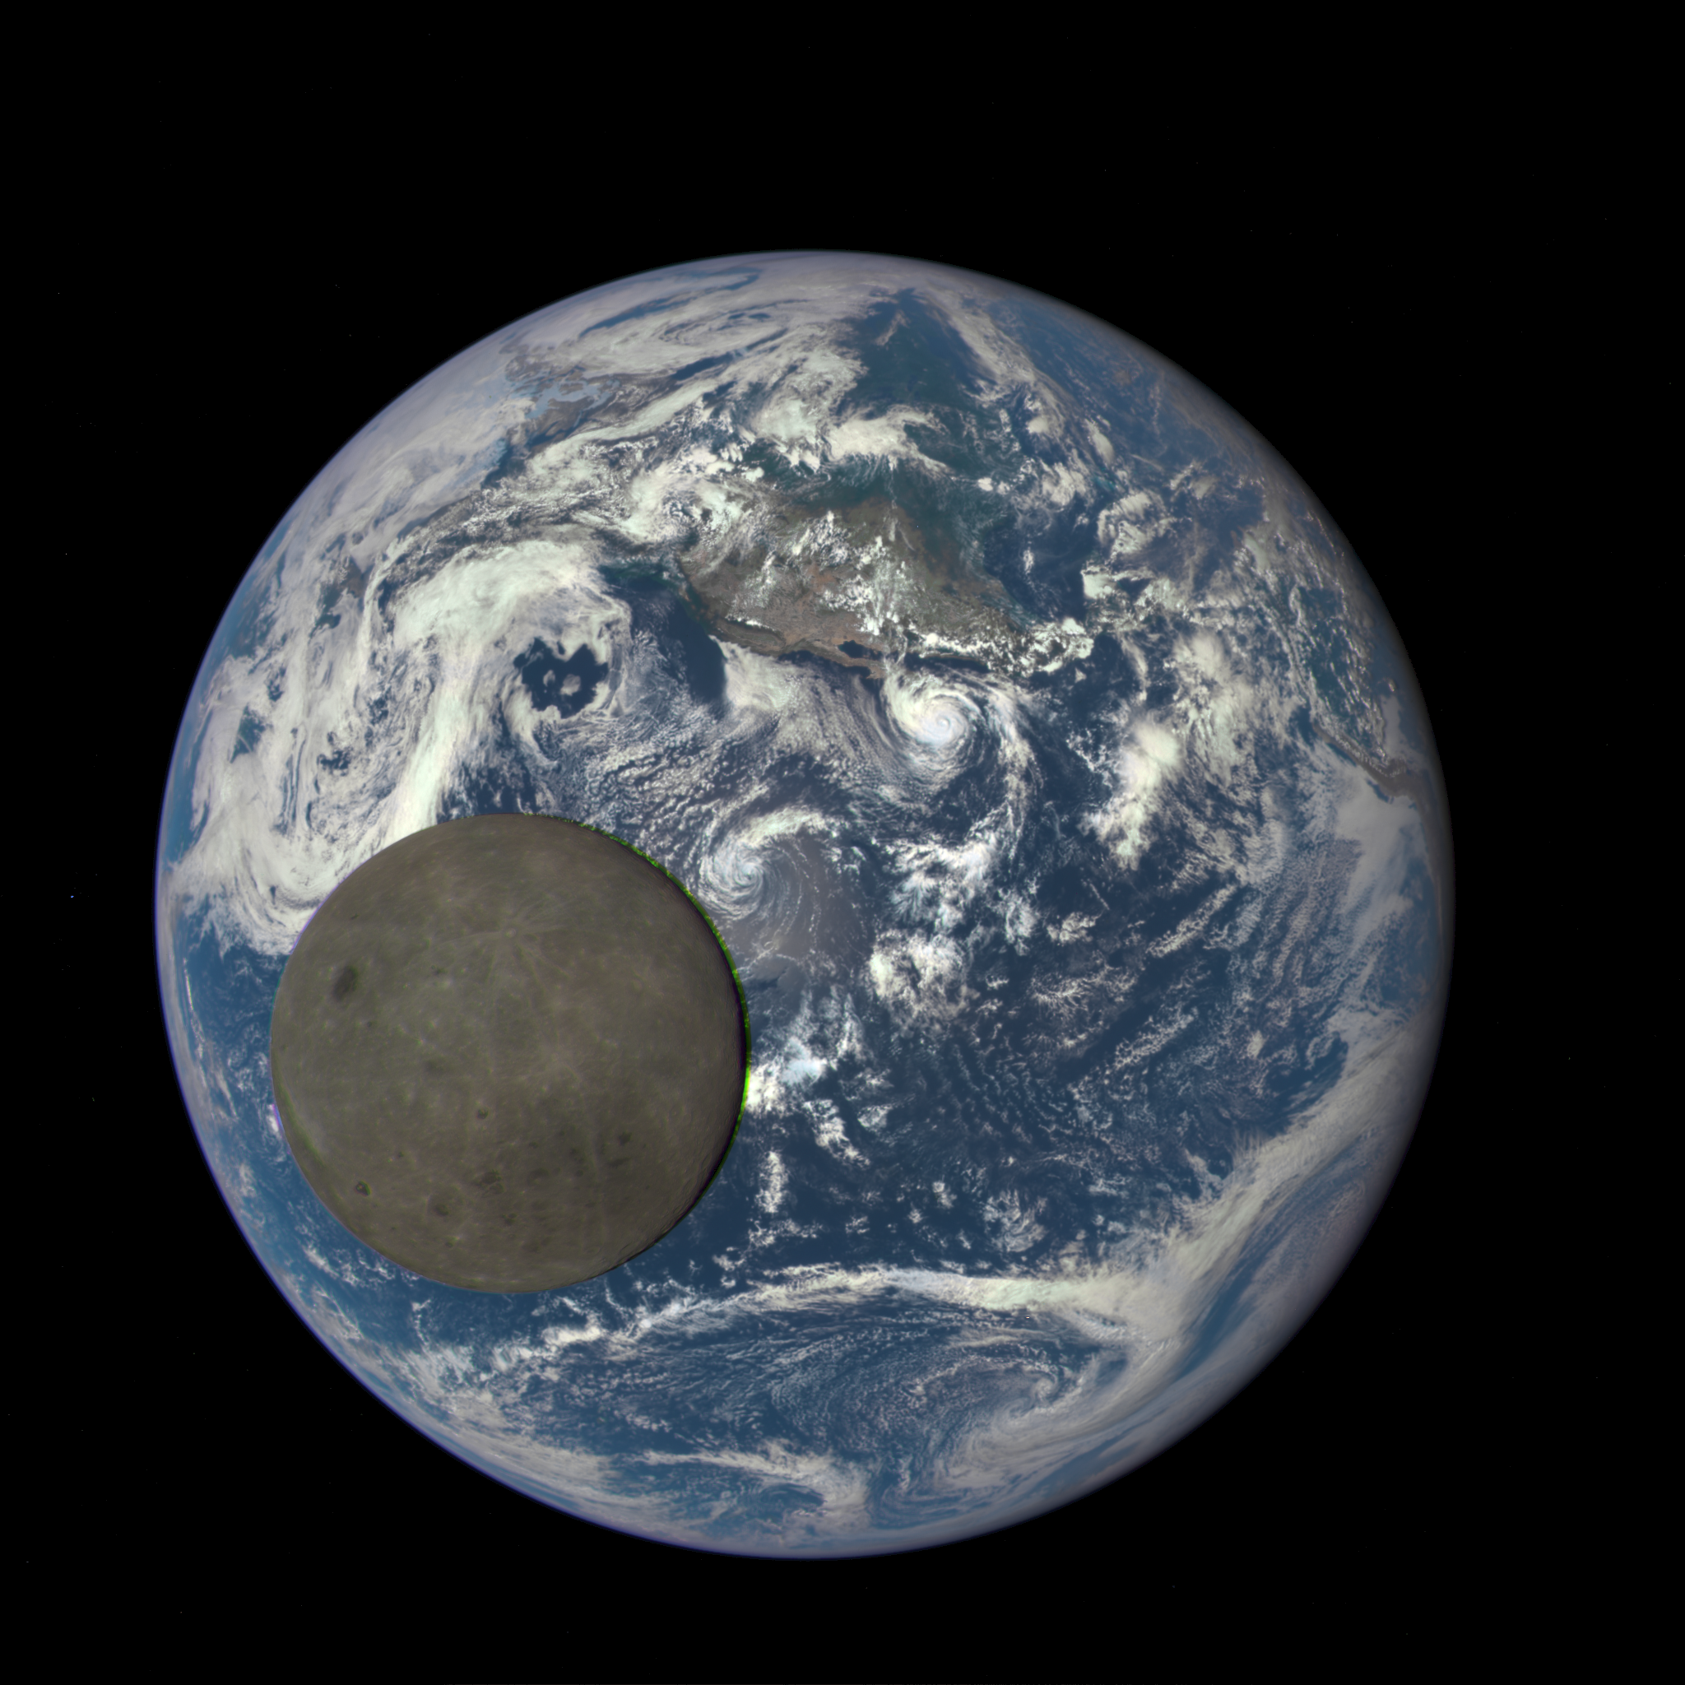
The Earth and Moon
 | Earth | Moon
Radius | 6,371 km | 1,737 km
Mass | 5.9x10²⁴ kg | 7.3x10²² kg
Circumference | 40,075 km | 10,913 km
Density | 5.51 g/cm³ | 3.34 g/cm³
Length of day | 23 hrs 56 min | 29.5 days
Avg. temperature | 57 F (13.8 C) | -298 F(-183 C) – 224 F (106 C)
Atmos. pressure | 1 bar | ~ 0

Slide 5
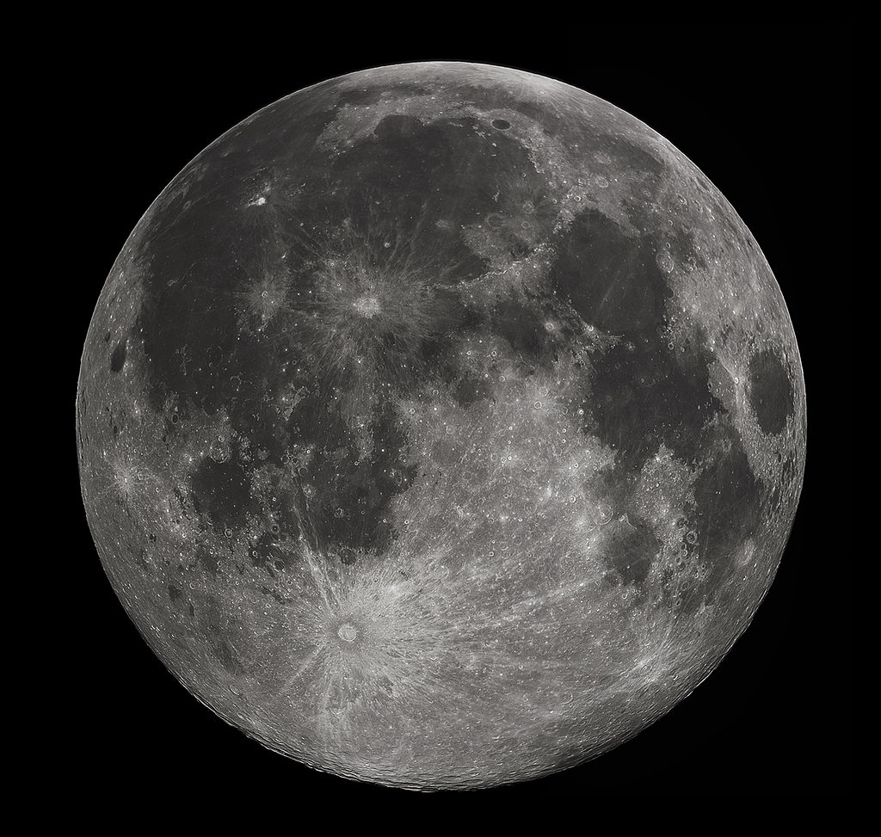
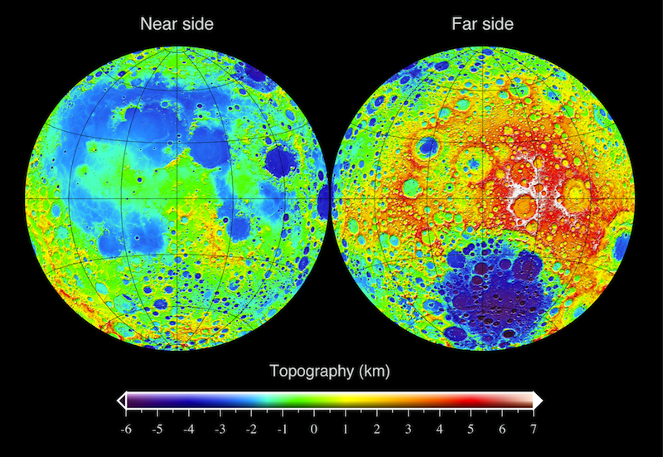
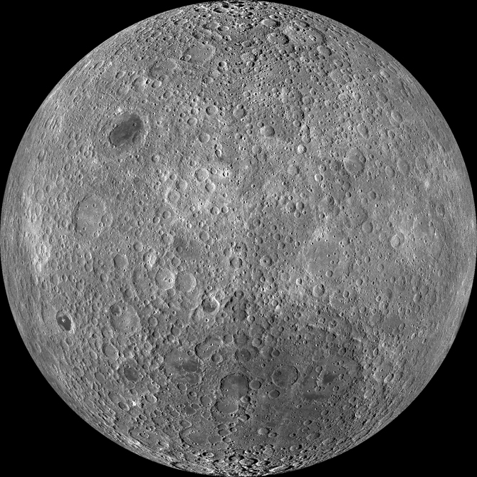
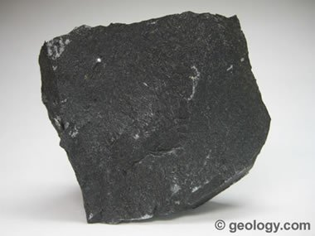
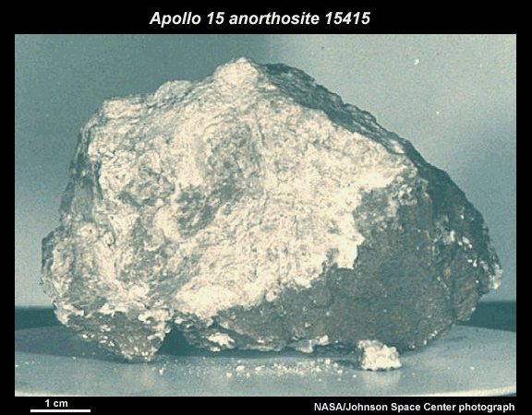
Maria
( 3 – 4 Ga)
basalt
Highlands
(> 4 Gya)
anorthosite

Slide 6
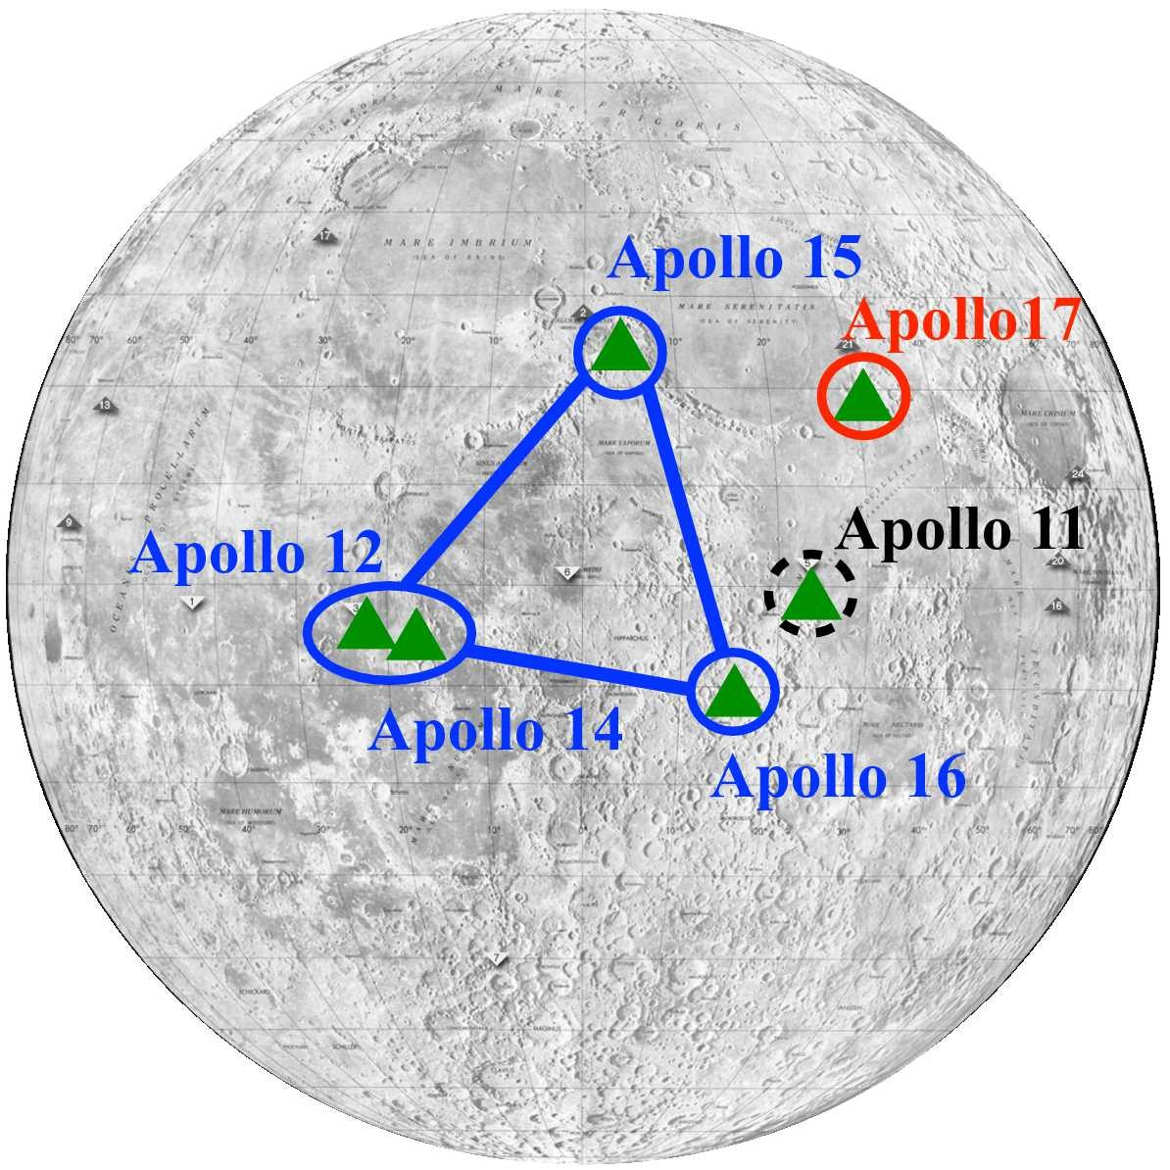
Apollo missions
First successful manned lunar landing was Apollo 11, on July 16, 1969
All of the successful Apollo missions carried seismometers!
The scientific instrument package ALSEP (Apollo Lunar Surface Experiments Package) included seismometers designed for both passive and active seismology.
The active source component (ASE; Active Seismic Experiment) consisted of short period geophones
The passive source component (PSE; Passive Seismic Experiment) consistend of a ‘mid-period’ instrument

Slide 7
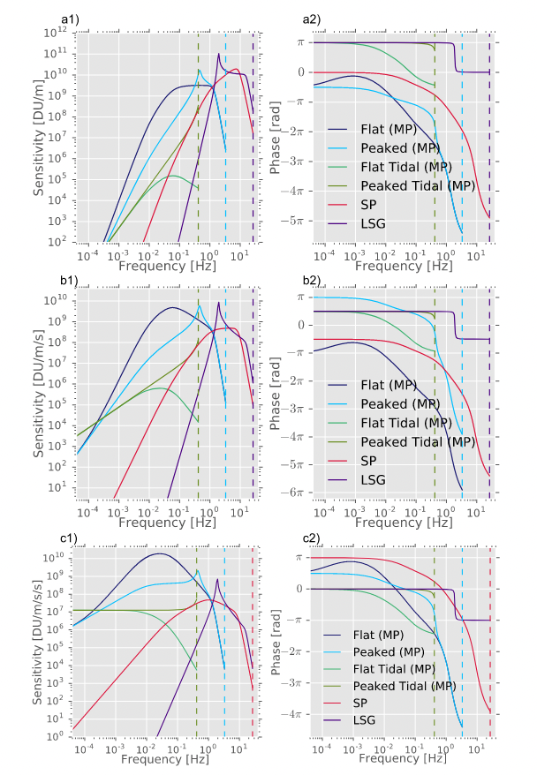
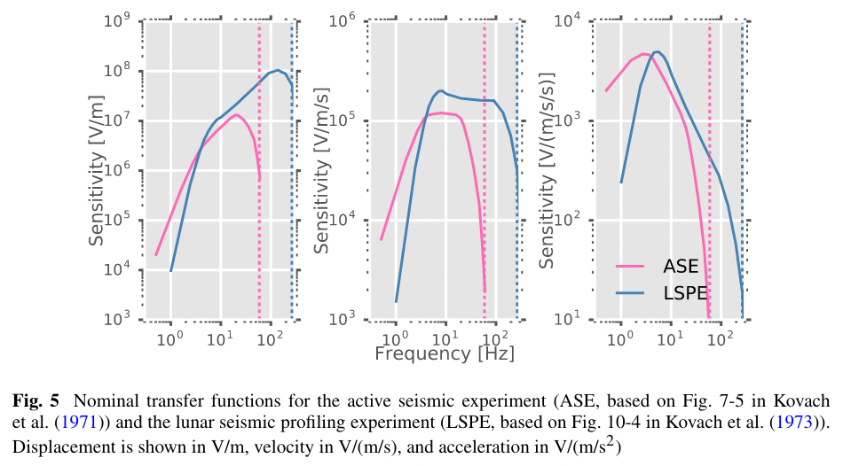
Instrument sensitivity
PSE instrument
ASE instrument

Slide 8
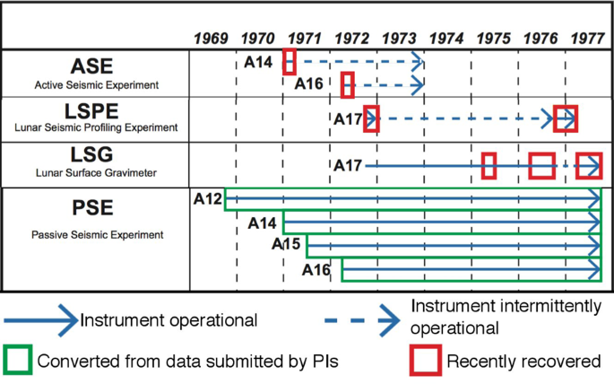
Overview of Lunar seismic experiments
Nunn et al., (2019)

Slide 9
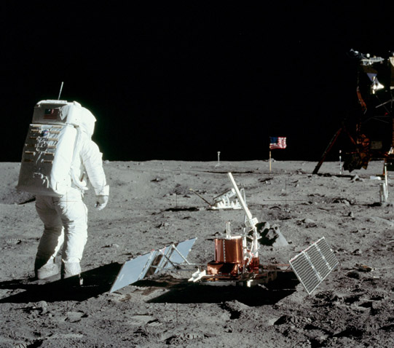
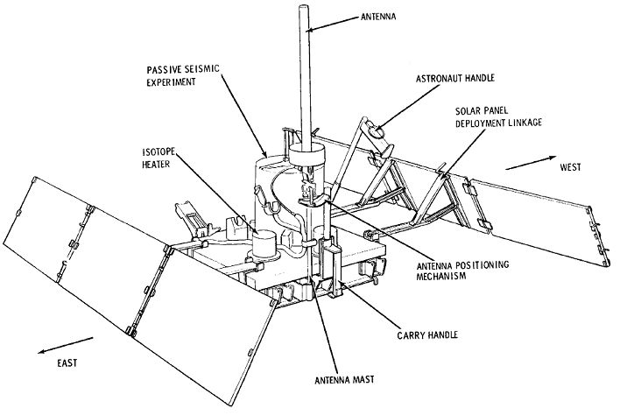
Passive Seismic Experiment (PSE)
Apollo 11 Lunar Module

Slide 10
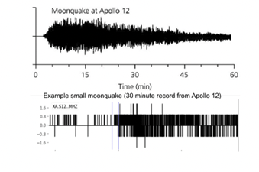
Bit-depth
To limit the amount of data, the digitizer of PSE recorded digital units between 0 – 1023 (10-bit data), which caused data resolution issues when the dynamic range is large.
artifact of coarse digitization

Slide 11
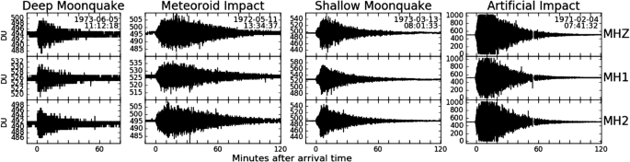
Moonquakes
Prior to Apollo, the moon was thought to be geologically dead. The only expected sources of seismicity were occasional meteorite impacts.
Surprisingly, many naturally occurring moonquakes were detected. The two main categories are deep moonquakes and shallow moonquakes.
The full catalog of seismic events from Apollo contains > 12,000 events (most of which are deep moonquakes)

Slide 12
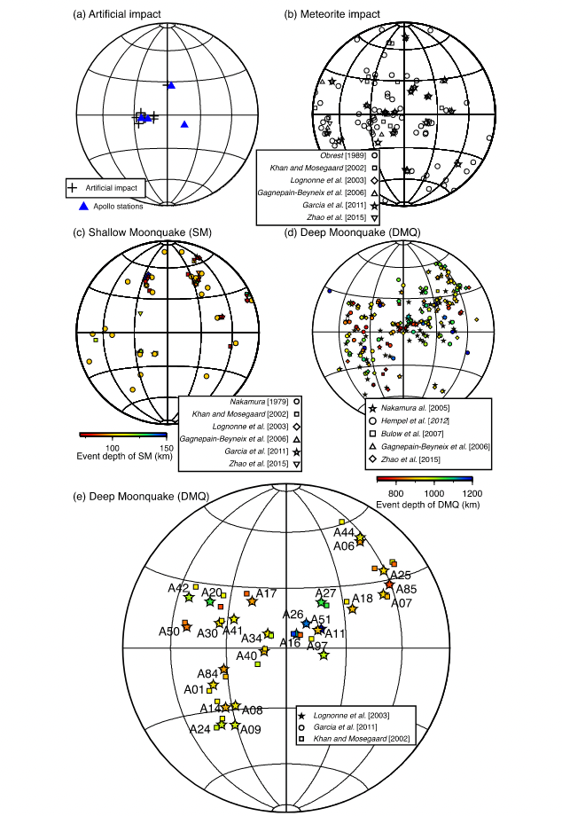
Moonquake locations
Over 12,000 events in total.
Event locations were possible using array techniques, and models of the velocity structure of the moon.
Deep moonquakes the most common natural sources, shallow moonquakes the least common natural sources.
No moonquakes from the far side! (Strongly attenuating layer in the deep moon?)
Garcia et al., (2019)

Slide 13
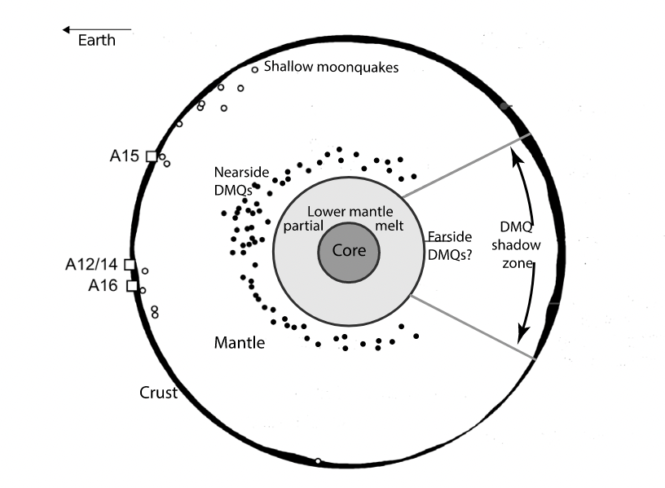
Deep moonquakes
Depths between 700 – 1,200 km.
Over 7,000 deep moonquakes cataloged.
Relatively small magnitudes (maximum magnitude of ~Mb 3).
Many quakes seem to share a common source region. These moonquake loci are commonly called ‘nests’.
Very likely to be tidal in origin. Their occurrence follows tidal periodicities.

Slide 14
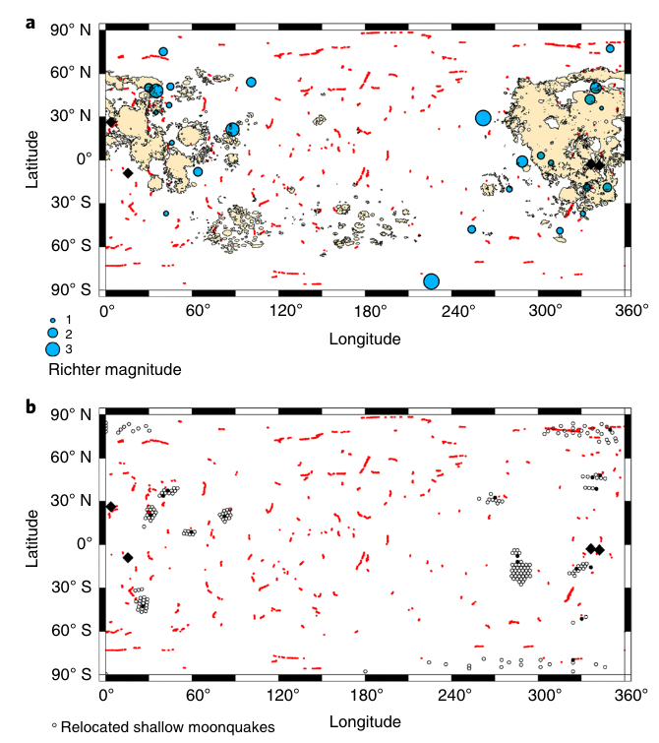
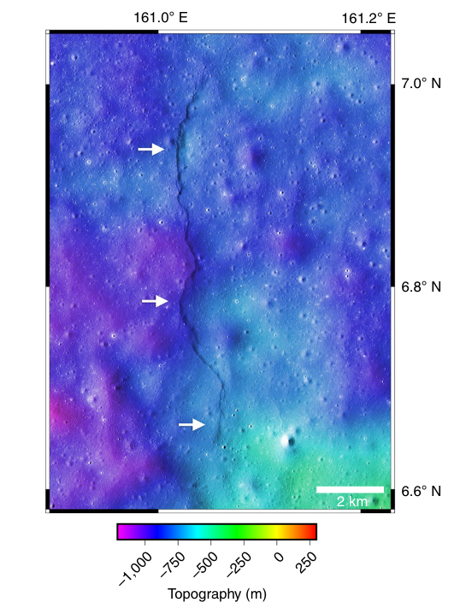
Shallow moonquakes
Only 28 events cataloged events.
Larger in magnitude than deep moonquakes (largest magnitude of ~ Mw 5).
Dominate the total moment release in the Lunar quake catalog.
Possibly related to compressional tectonics (occur near mapped lobate scarp features).
Watters et al., (2019)

Slide 15
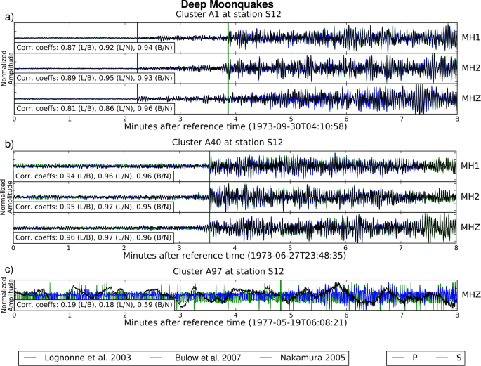
Deep moonquake stacks
Due to the waveform similarity and close proximity between different events in a deep moonquake ‘nest’, the waveforms can be stacked to enhance signal to noise ratio.

Slide 16
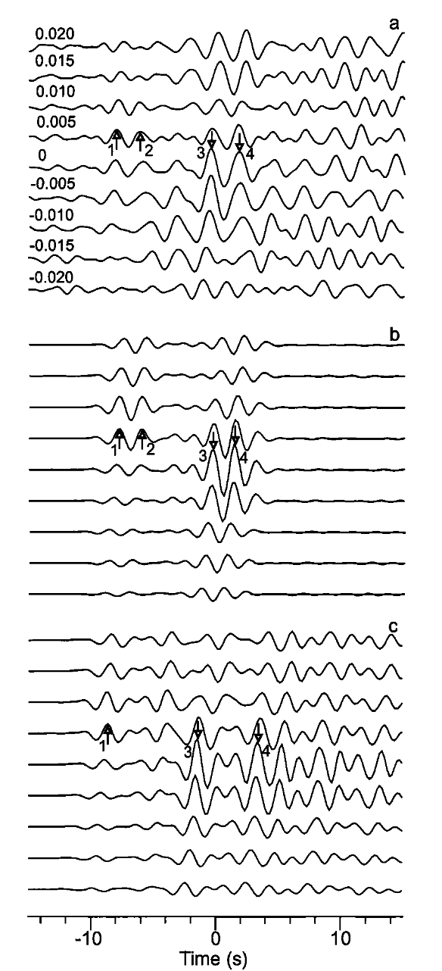
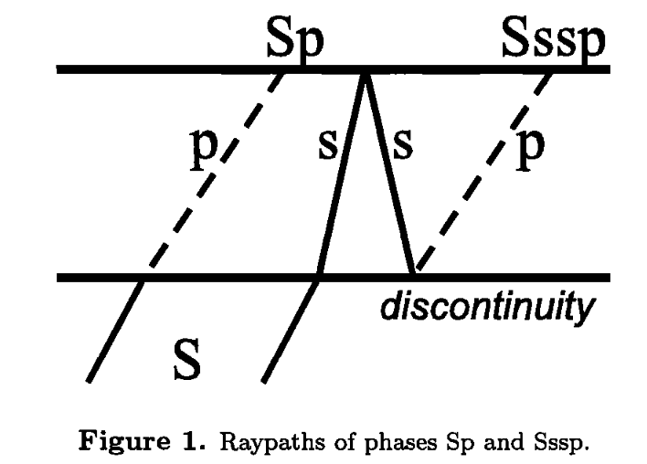
S-to-P receiver functions
Vinnik et al., (2001) performed S-to-P receiver function analysis on deep moonquake stacks to study crustal structure below Apollo 12.
S-to-P is preferred because the P-to-S phases are often lost in the strong scattering coda.
Results show a crust-mantle boundary at ~55 km depth and a shallow low velocity layer ~1.4 km thick

Slide 17
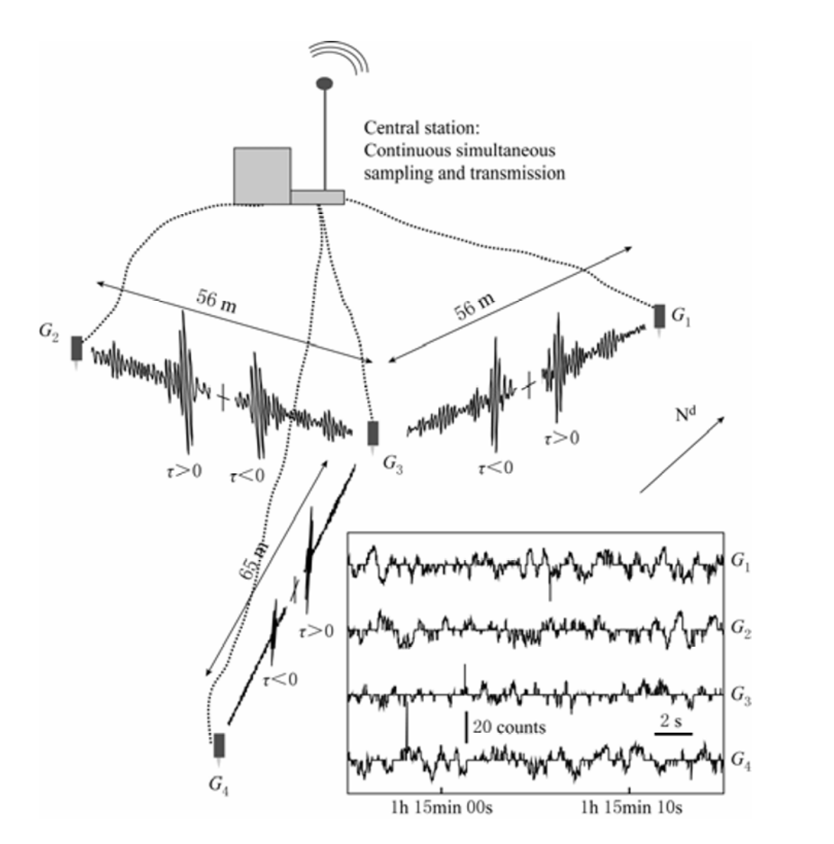
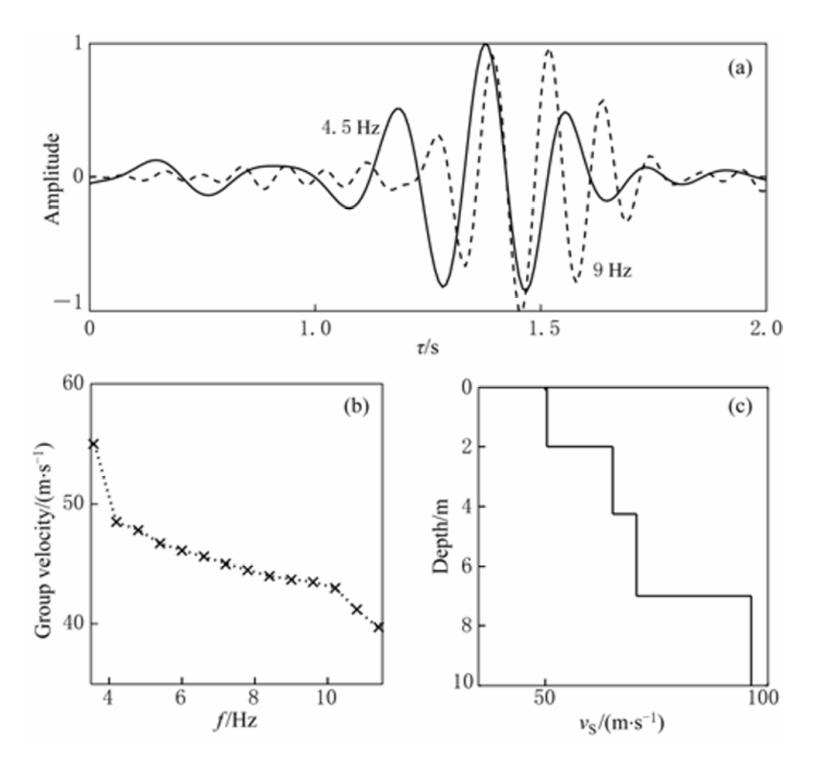
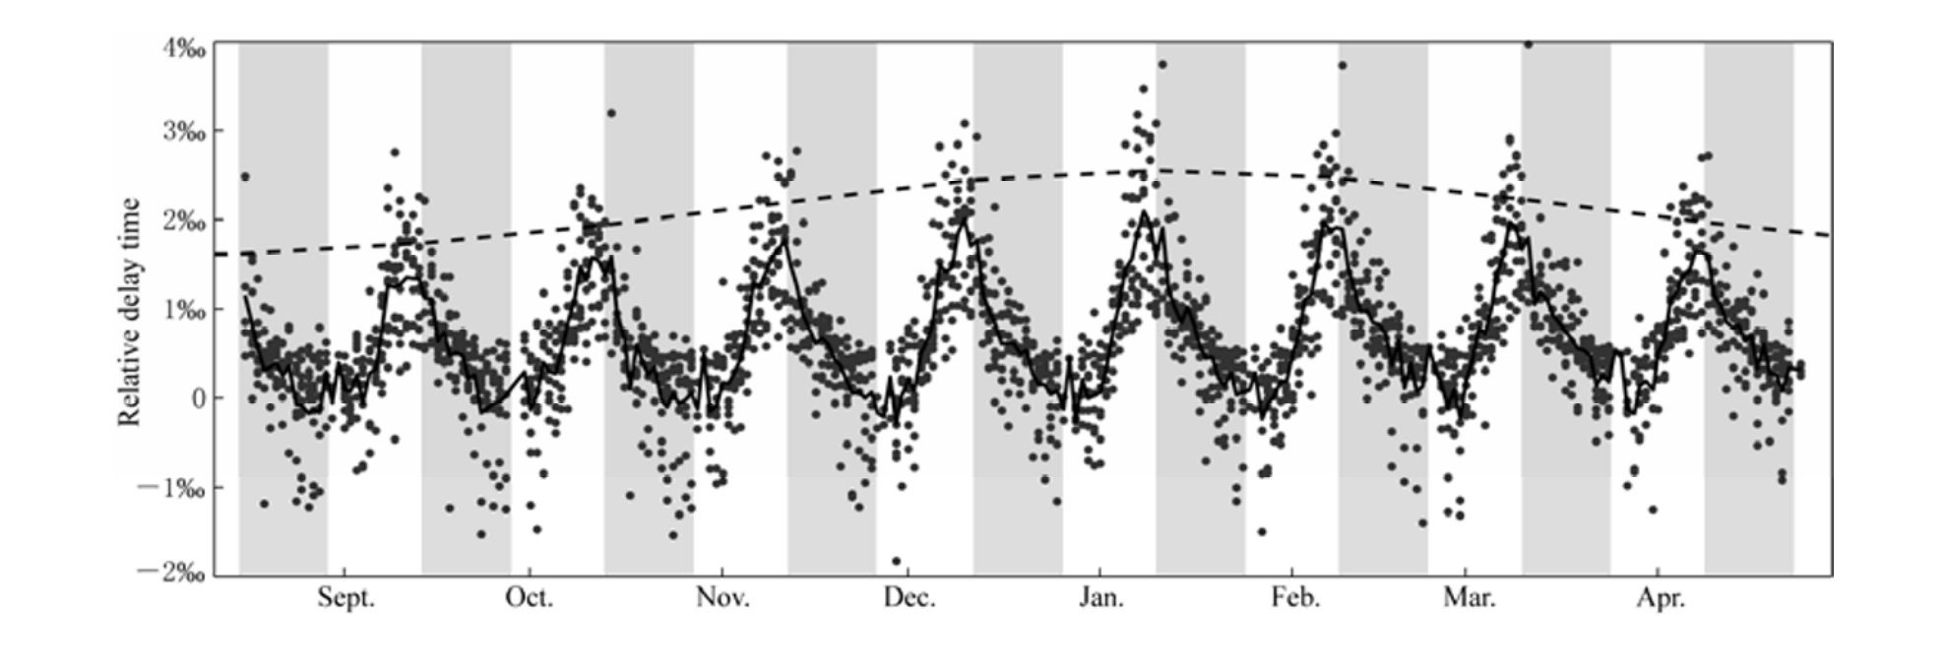
Ambient noise correlations
Sens-Schonfelder & Larose (2010) analyzed ambient noise correlations between Apollo 17 geophones to study local properties of the shallow subsurface.
Short period Rayleigh waves were recovered, and inverted for Vs in the upper ~10 m. Very slow velocities (< 50 m/s) reflect unconsolidated regolith material.
Travel time delays of Rayleigh waves between stations change over time! This is due to the changes in subsurface temperature over the course of a Lunar day.

Slide 18
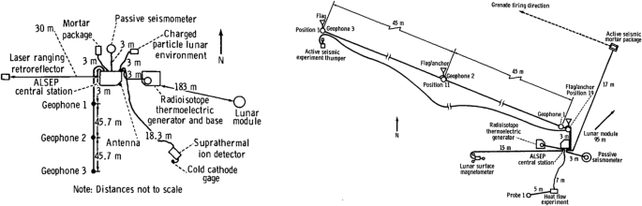
Active Seismic Experiment (ASE)
Rule of thumb: Active source experiments can ‘see’ to a depth of roughly half of the length of the profile.
Apollo 14
Apollo 16

Slide 19
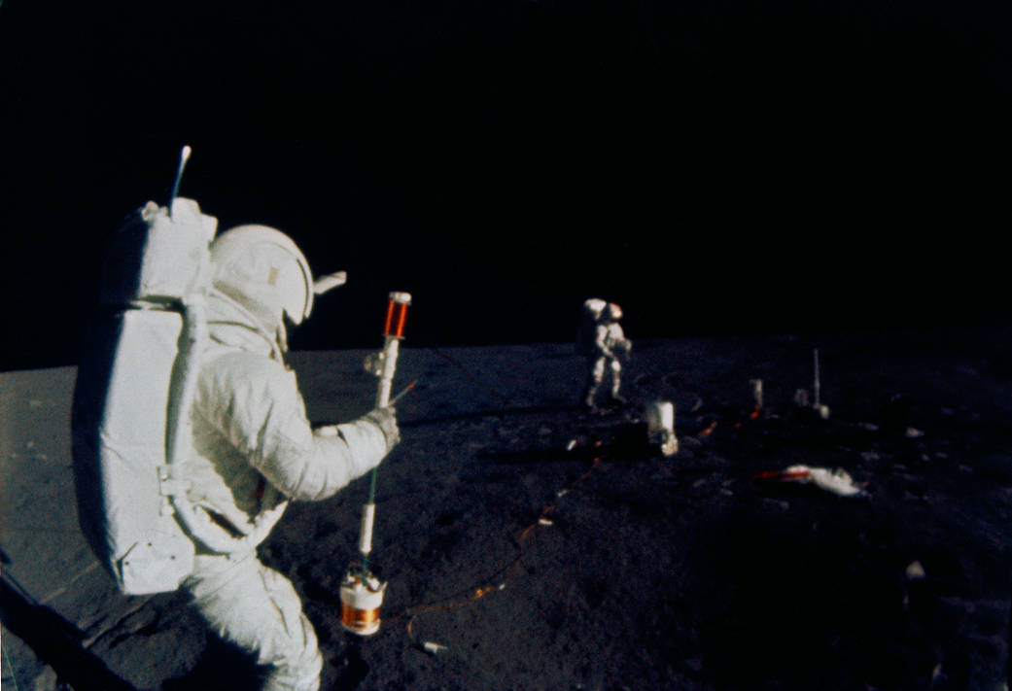
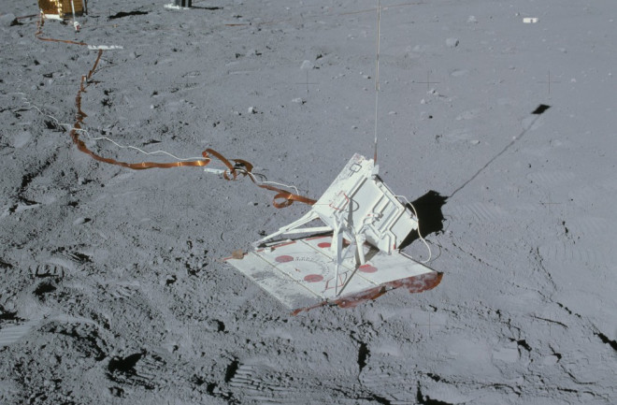
Active sources
Multiple types of active sources were used for ASE, including thumpers (small explosive charges that produce a shotgun-like blast) and mortars (rocket propelled grenades).
Thumpers would be fired in evenly spaced increments along the seismic line.
Only Apollo 16 used mortars. They were fired remotely and launched explosives up to 1.3 km from the seismic line
Apollo astronaut using a thumper during an active seismic experiment
Mortar package assembly

Slide 20
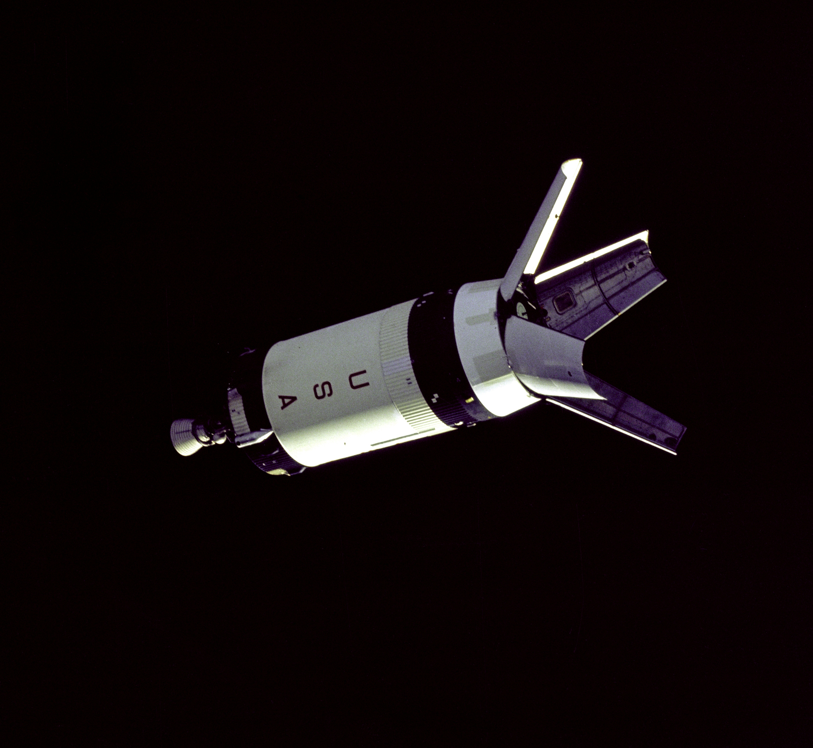
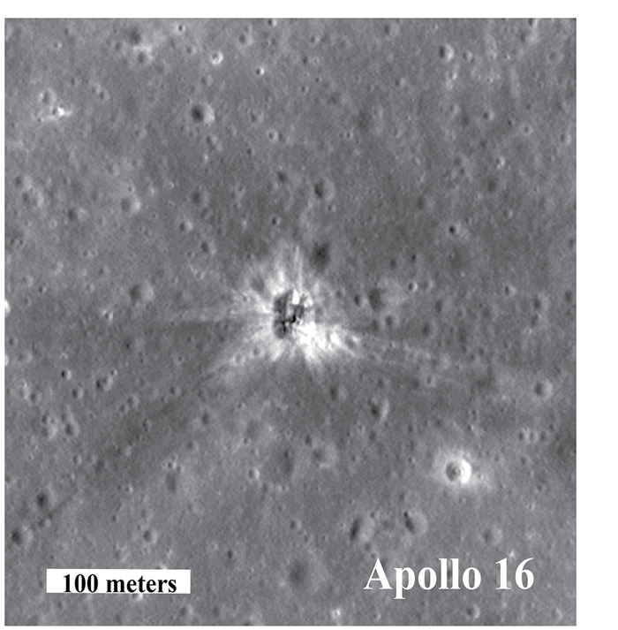
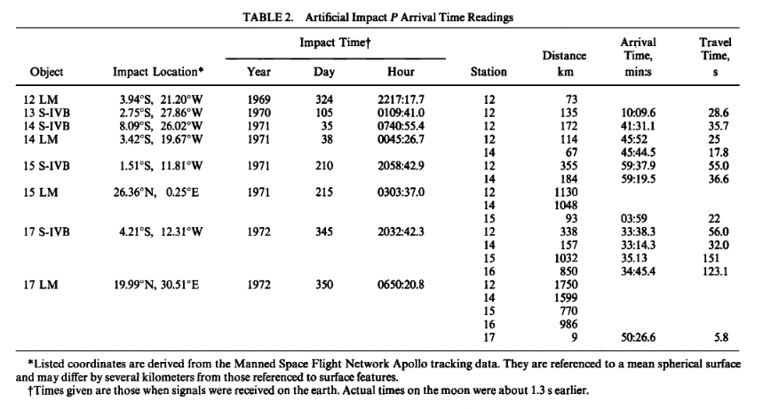
Artificial impacts
Saturn rocket upper stages (S-IV B) and Lunar Module ascent stages, were purposely crashed into the lunar surface to create artificial impacts.
These are particularly useful seismic sources because their location and timing are precisely known.
Enabled first determinations of seismic velocity structure of the Moon’s crust and uppermost mantle (Toksoz et al., 1972)

Slide 21
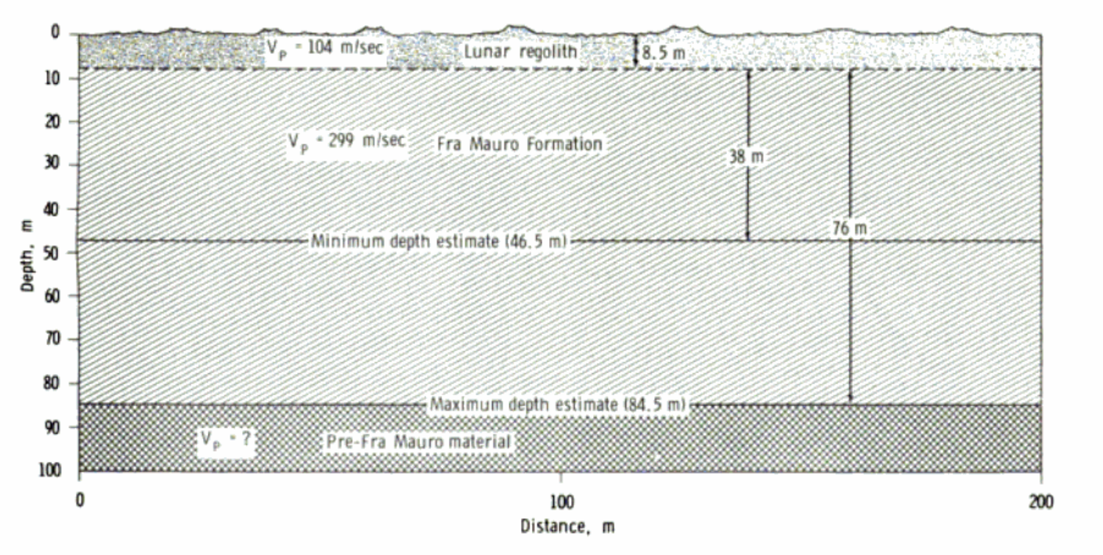
Velocity models from active source imaging
Active source experiments from Apollo 14 and 16 using thumpers were used to constrain the velocity structure in the upper 10’s of meters of subsurface
Data is fit with layered models with very slow velocity (Vp ~ = 100 m/s) in the upper layer < 10 m thick layer, overlying slightly higher velocities (Vp = ~300 m/s). This likely reflects an unconsolidated regolith layer overlying ejecta.
Apollo 14 site. Kovach et al. 1971

Slide 22
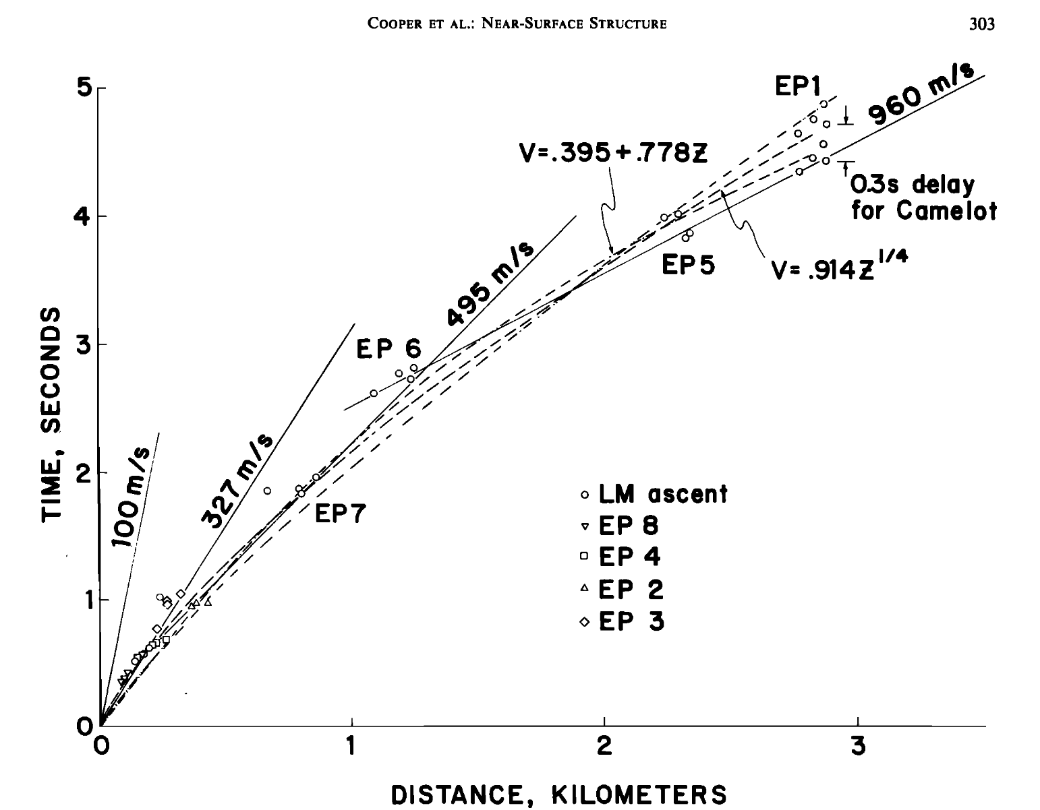
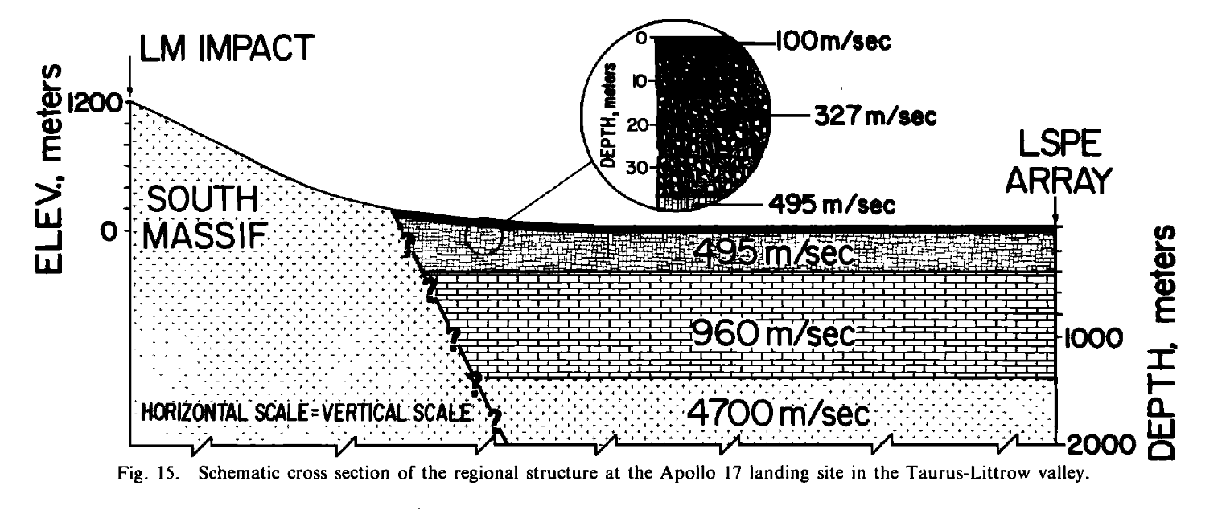
Apollo 17 LSPE results
The Lunar Seismic Profiling Experiment (LSPE) of Apollo 17 allowed the largest offsets of the active source experiments.
Structure was constrained to > 1 km depth.
Cooper et al., (1974)

Slide 23
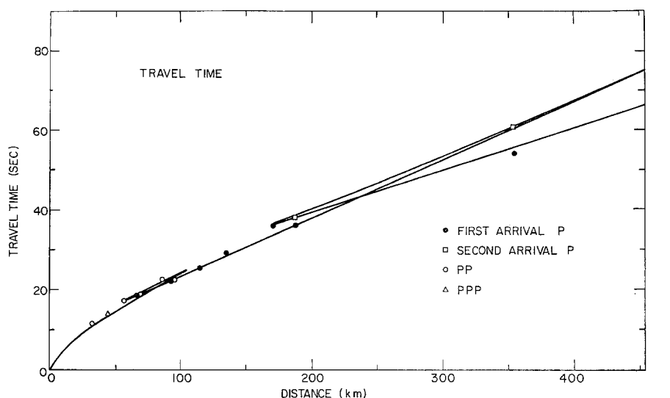
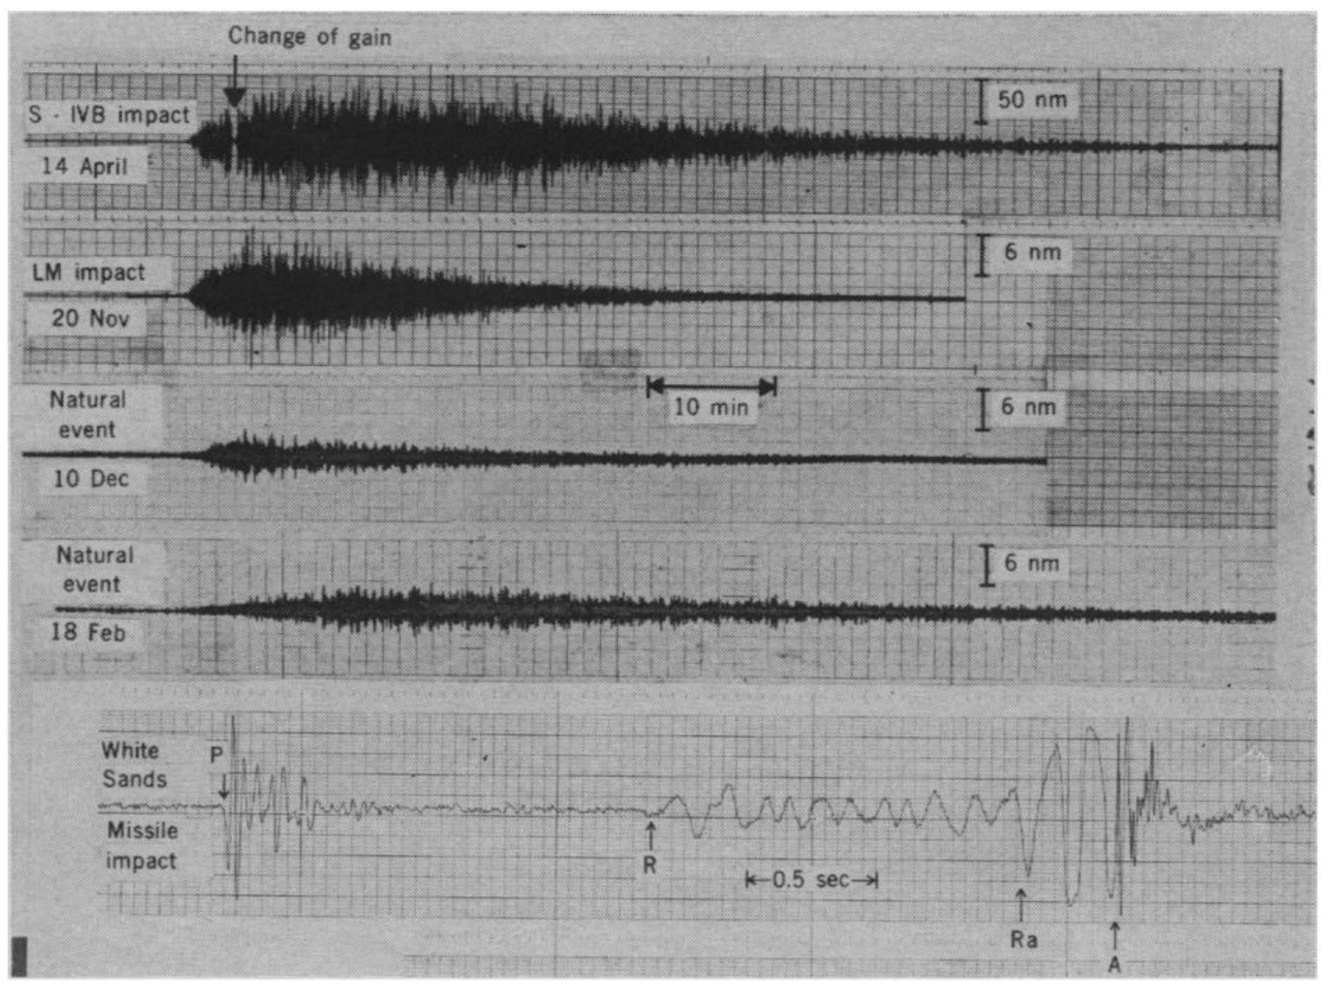
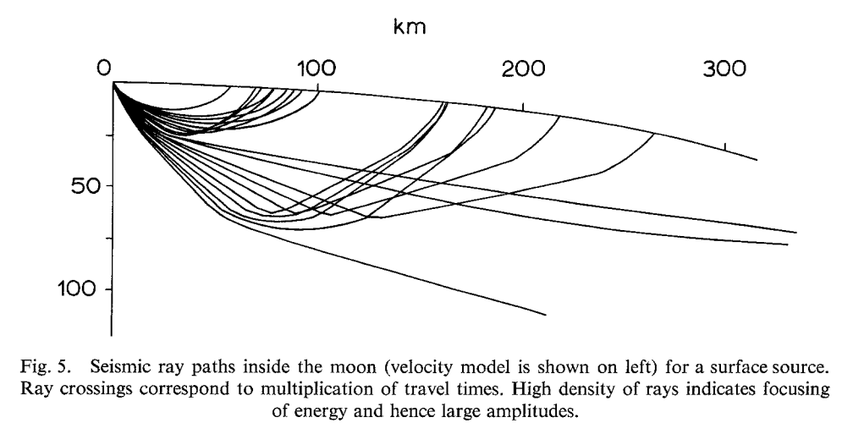
Results including artificial impact data (Toksoz et al., 1972)
Artificial impacts were recorded at > 300 km distance.
Maximum ray turning points of > 70 km (turning in the mantle).
Toksoz et al., (1972)

Slide 24
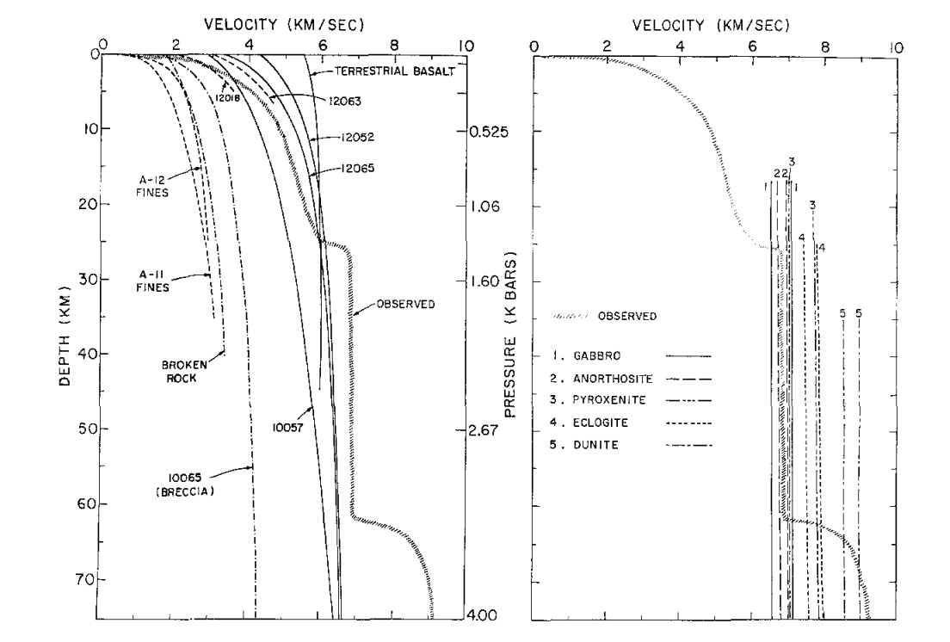
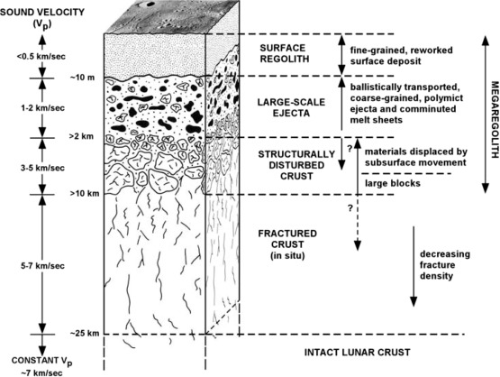
Lithological interpretation
Major layers of crust include:
Shallow surface regolith (to ~ 10 m)
Ejecta layer (to ~1 – 2 km)
“Structurally disturbed crust” ( to ~10 km)
Fractured crust
Intact crust
Crust mantle boundary at ~65 km
Toksoz et al., (1972)

Slide 25
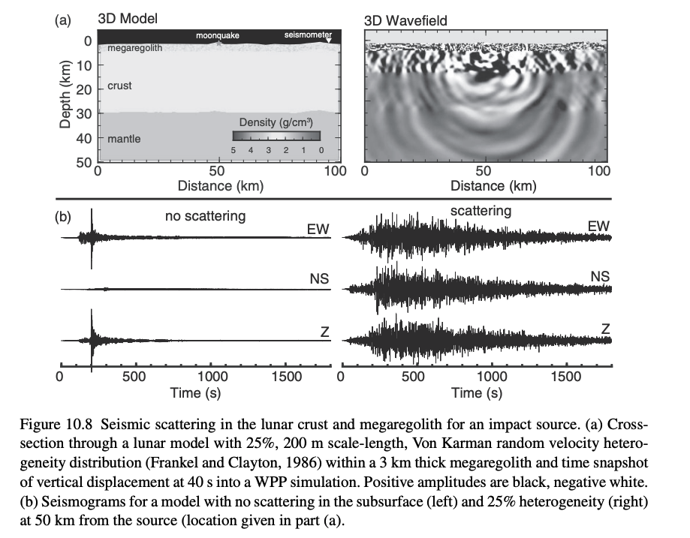
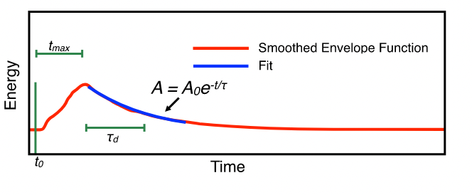
Lunar scattering
Simple layered models of the lunar interior do not reproduce the emergent onset and long duration of moonquake signals
The characteristic ‘risetime’ and ‘decay time’ of the seismic envelopes relate to the scattering properties and the attenuation of the subsurface.
Based on fitting diffusive envelopes, Q in the crust is determined to be very high (Qs > 3000) (e.g., Latham et al., 1970).
High Q values require no fluids.

Slide 26
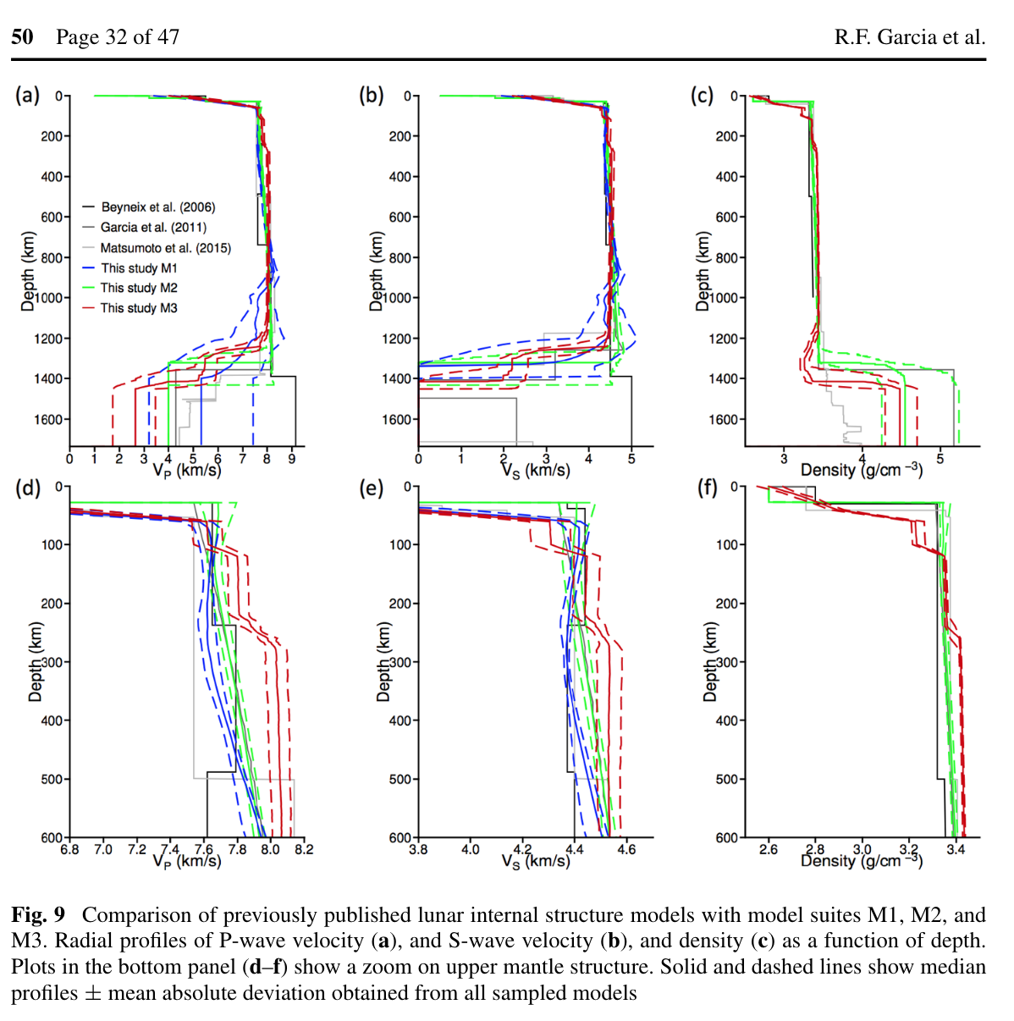
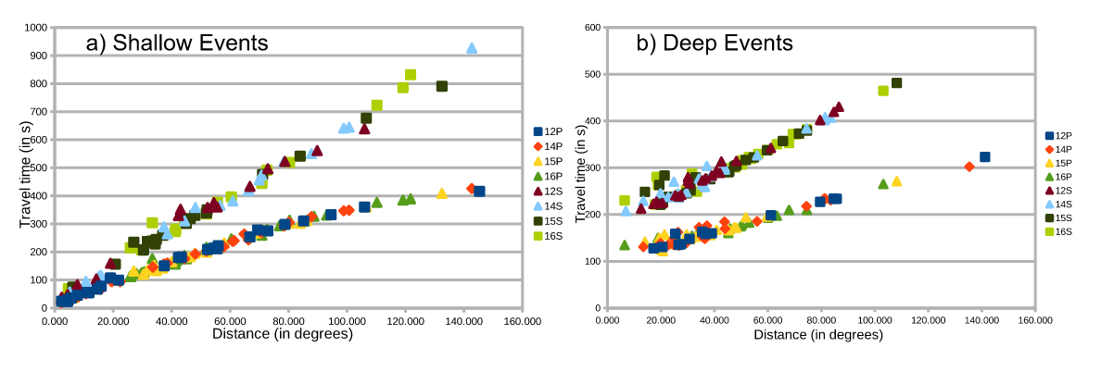
Deep mantle velocity (from PSE)
Travel time inversions of deep, shallow moonquakes, and impacts were used to constrain the deep mantle structure (see Garcia et al., 2019 for a review).
Inversions generally find shallower crust than early active source experiments (~30 km thick). Other common features include a LVL ~50 – 200 km depth.
Models in good agreement between ~600 – 1200 km depth.
Garcia et al., (2019)
Nunn et al., (2019)

Slide 27
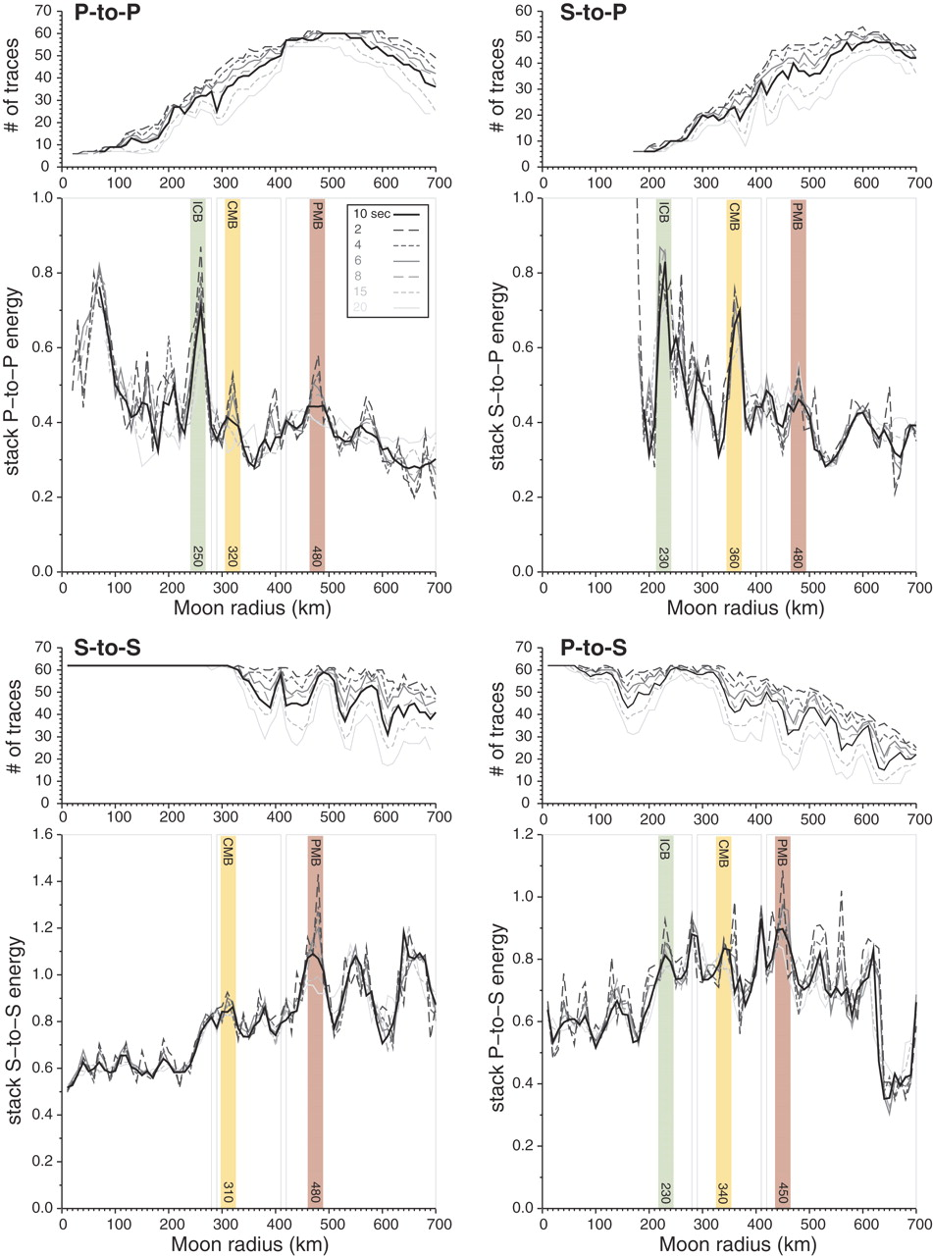
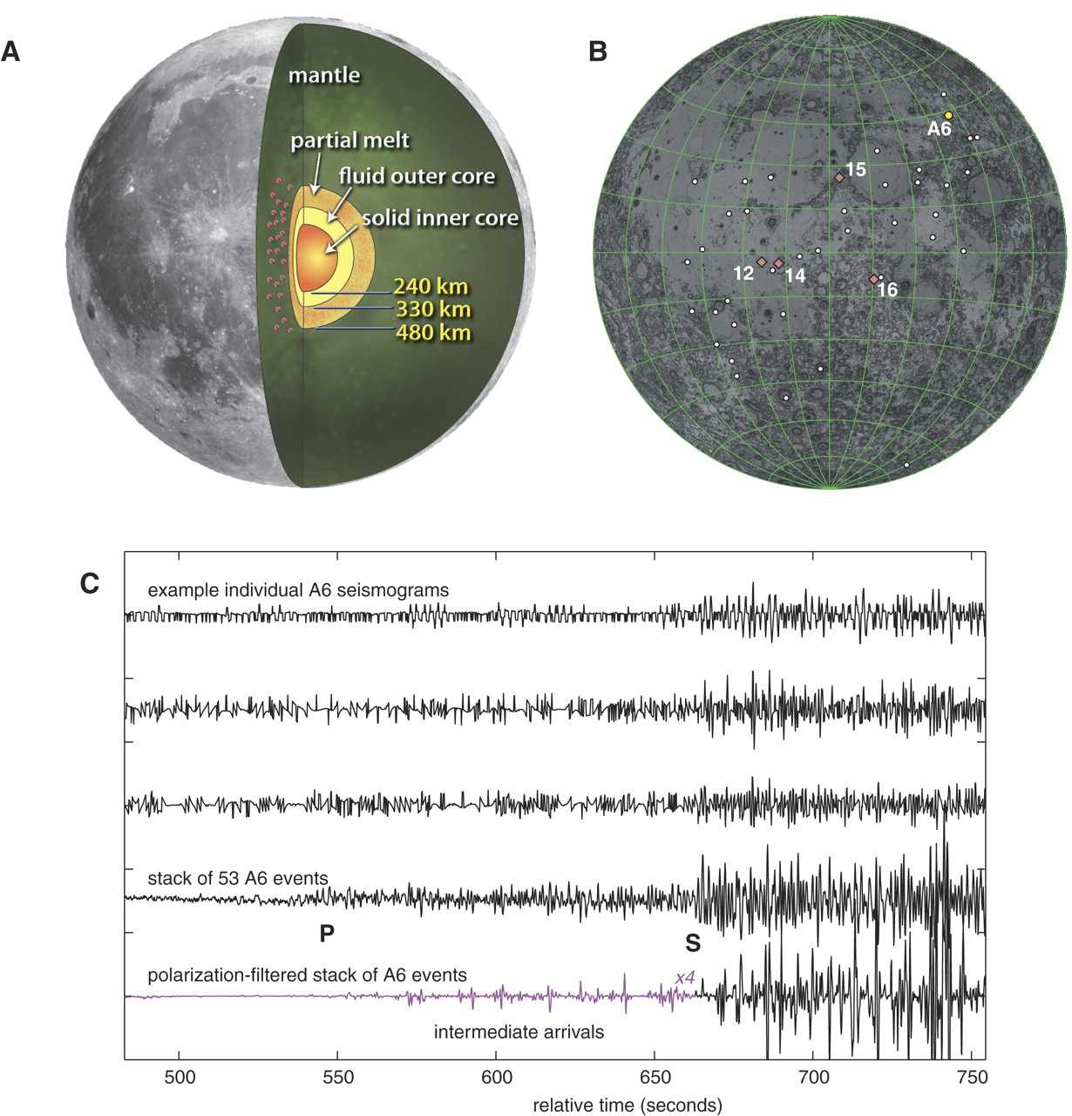
Discovery of the lunar core
Initial attempts at lunar structure inversions were unable to resolve the core depth/ structure.
Weber et al., (2011) used stacks of deep moonquake data to enhance signals of deep reflections from the core.
Due to the highly scattered nature of the signals, individual reflected phases can not be interpreted. Instead, waveform stacks from different deep nests were time shifted and stacked according to possible lunar velocity models.
Peaks in the stacks associated with particular depths provide evidence for a seismic discontinuity at that depth.

Slide 28
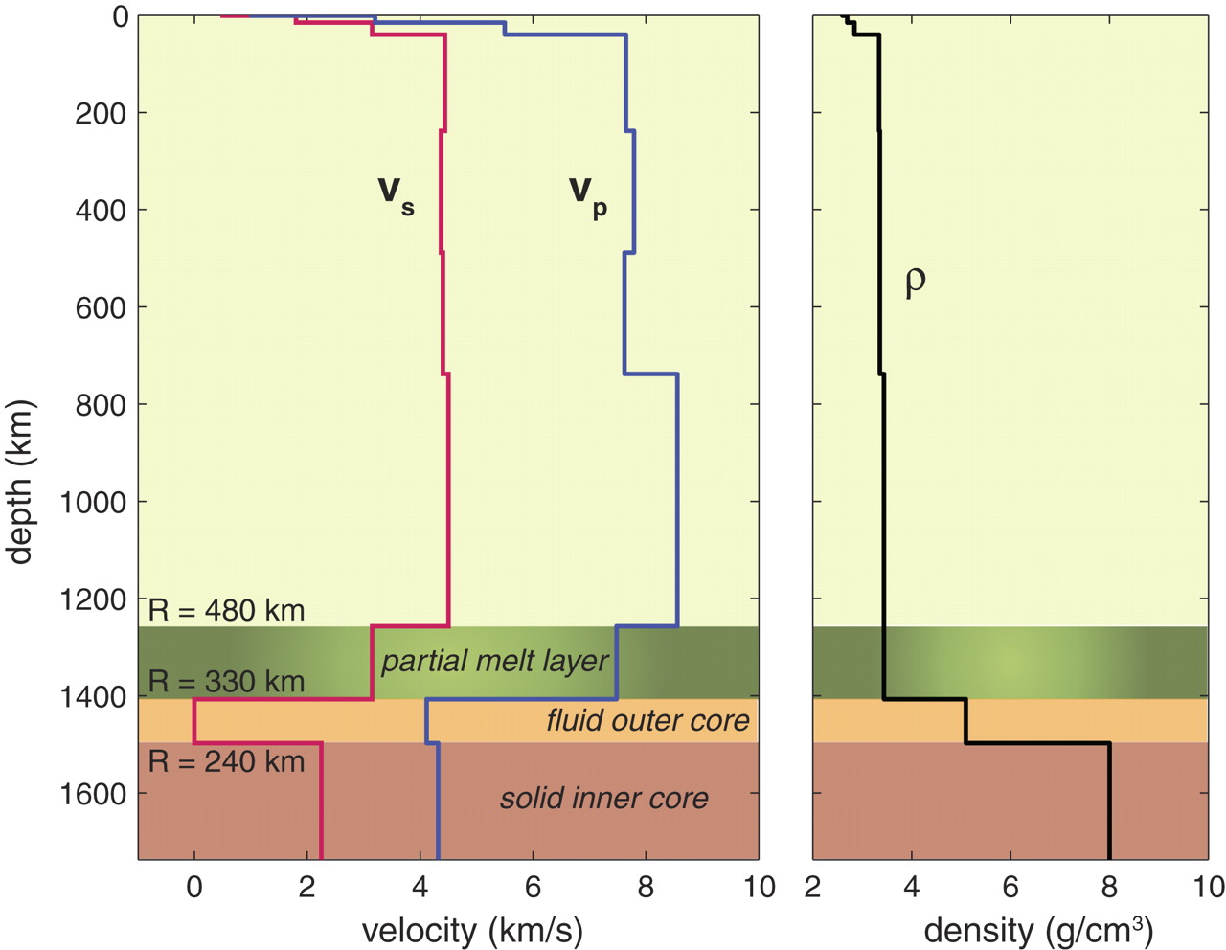
Lunar core properties
Using this approach, evidence for 3 deep discontinuities was found:
A partially molten layer at the base of the mantle (radius = 480 km)
The core-mantle boundary (radius = 330 km)
A solid inner core (radius = 240 km)
The core radius is small compared to the lunar radius (~18 % of the total radius).
~60% of the core is liquid by volume
Core consists of less than 6% of light elements by weight

Slide 29
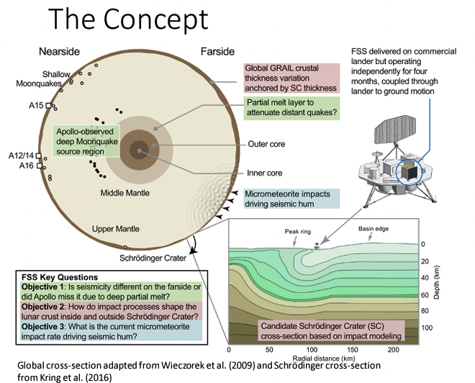
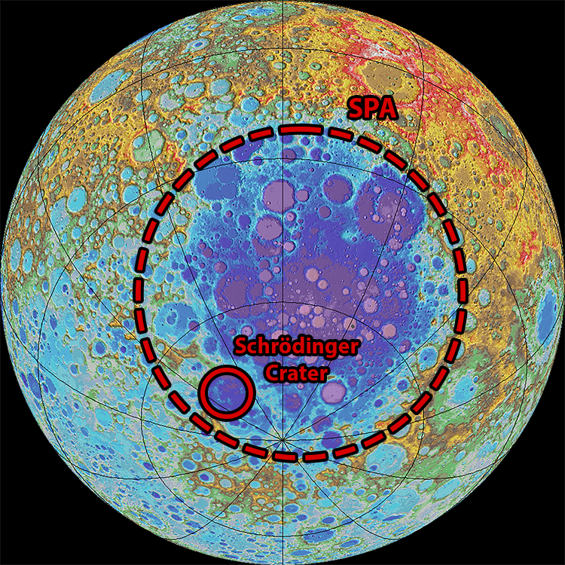
Upcoming lunar seismology (Farside seismic suite)
Farside Seismic Suite (FSS) will launch in 2025, and land at Schrodinger Crater near the south pole on the far side.
FSS will include a single channel broadband vertical seismometer (VBBZ), which technology developed for InSight.

